Slide 1
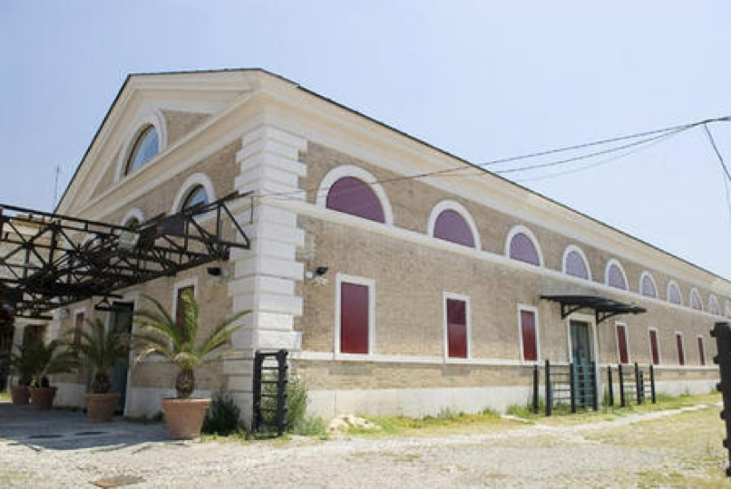
Workshops for the future – Movement and life – The materials of public space
Roma. Testaccio. Ex-mattatoio. Biennale Spazio Pubblico

Slide 2
On February 7th, The Department of Architecture of the University Roma Tre hosted in the classroom "Adalberto Libera", according to the activities planned for the Public space in the Biennale, the protagonists of the second edition of the project WORKSHOP FOR THE FUTURE: URBAN REGENERATION, INNOVATION, WORK AND BUSINESS. It is an initiative of ASL,held by the Association Città Ibrida, in cooperation with the Camera di Commercio situated in Rome, 3 Districts, 5 high schools, 5 companies , 150 students and 20 operators involved to collaborate in a laboratory called MOVEMENT and LIFE, THE MATERIALS OF THE PUBLIC SPACE.
The WORKSHOP FOR THE FUTURE initiative, founded in 2017/2018, was the first step towards the development of a training course that contributes to strengthening a structural policy in favour of the growth and development of cities. HYBRID CITY with the aim of consolidating what was learned in the first edition of OFFICINE DEL FUTURO, suggested to build in 2019, through a new didactic and practical path, a laboratory of URBAN ART that has involved students of high schools from Districts IV-V and VI in Rome, the Guys of the Day Center “Factory of Dreams" in via delle Canapiglie , Torre Maura and craft companies.

Slide 3
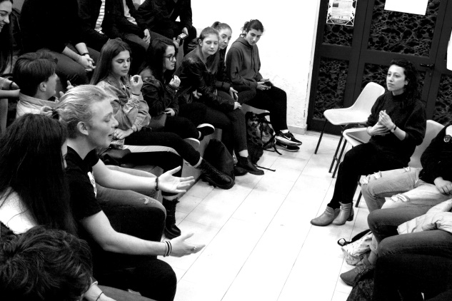
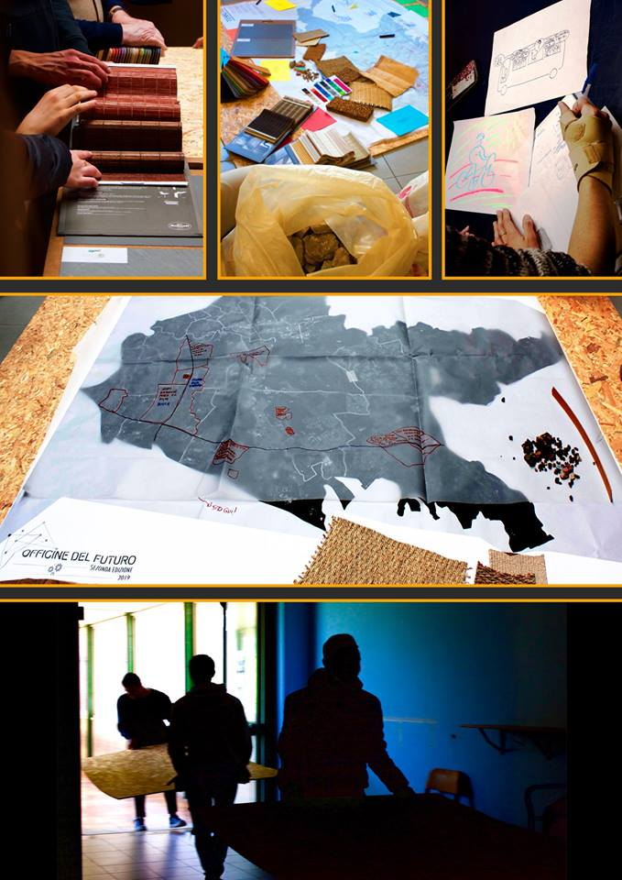
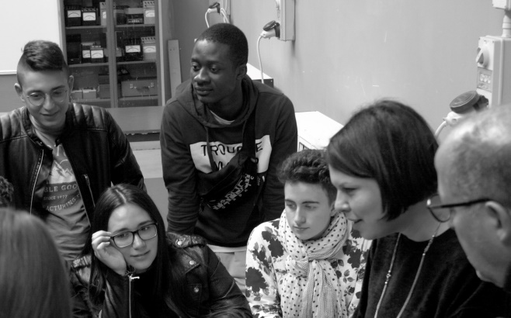
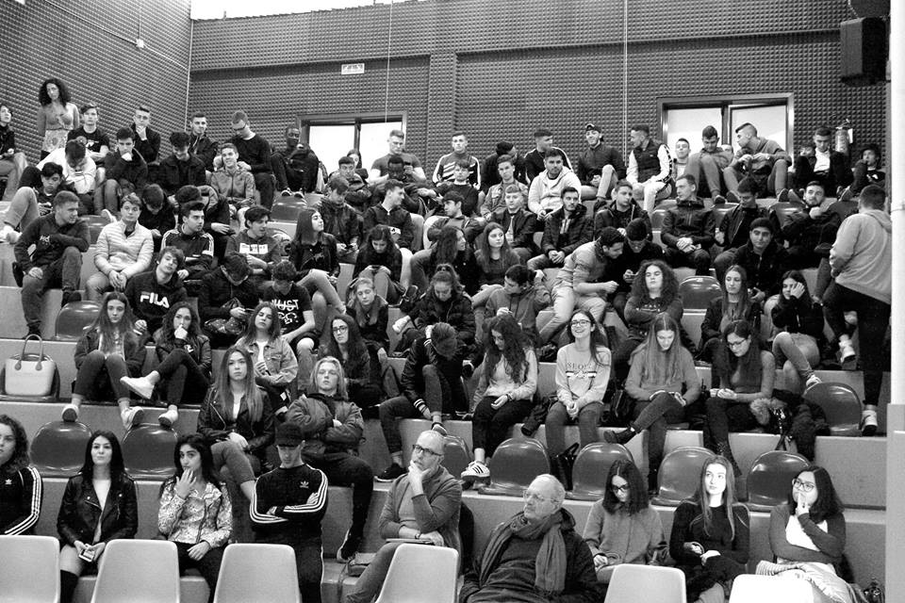
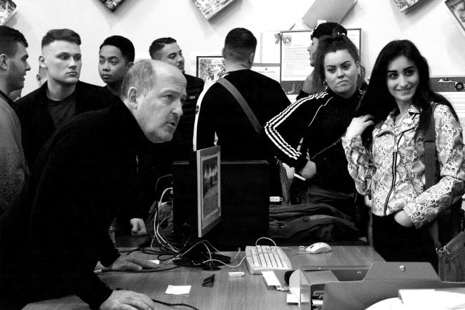
The guys have worked together with the companies to make PROTOTYPES FOR THE PUBLIC SPACE (The Biennale Square) to assemble and transform inside the exhibition of Biennale 2019.

Slide 4
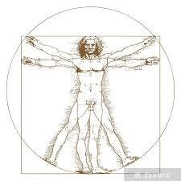
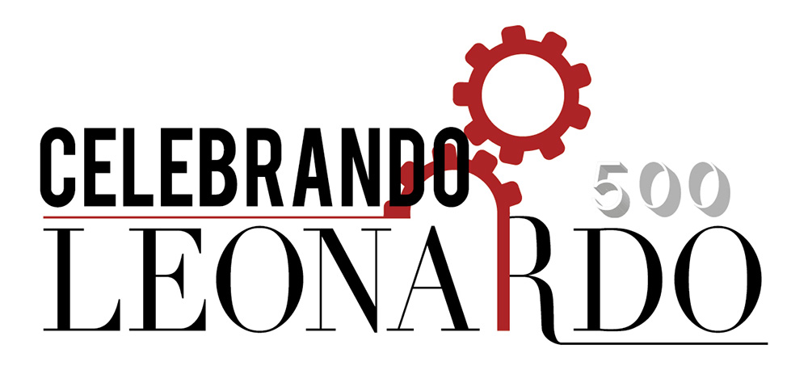
The project name is” Celebrating Leonardo” in the “500th anniversary from Leonardo da Vinci’s death for The public space prototypes are inspired to Leonardo’s life, works and genius, combined with Industry 4.0

Slide 5
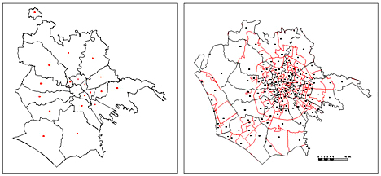
The project of ASL is aimed at the construction of prototypes for public space ,which are focused on two educational objectives for students: the civic awareness of the social role of the public space; the acquisition of basic skills, techno-professional and transversal skills, in cooperation with companies and pioneer-entrepreneurs of productive processes.

